Slide 1
Číslo šablony: III/2
VY_32_INOVACE_P2_2.20
Tematická oblast: Reálie
NEW ZEALAND – PLACES OF INTEREST
Typ: DUM - kombinovaný
Předmět: AJ, AJS
Ročník: 6. r.(6leté), 4. r. (4leté)
Zpracováno v rámci projektu
EU peníze školám
CZ.1.07/1.5.00/34.0296
Zpracovatel:
Mgr. Petra Bruková
Gymnázium, Třinec, příspěvková organizace
Datum vytvoření: leden 2014

Slide 2
Metodický list
DUM seznamuje studenty se základními informacemi o známých městech na Novém Zélandu formou prezentace. Součástí DUMu jsou také osobnosti, které Nový Zéland proslavili. Tento DUM je vhodné doplnit DUMem Nový Zéland – všeobecné informace.
DUM procvičuje získané vědomosti pomocí cvičení v závěru prezentace. Součástí DUMu je i řešení cvičení.
Inovativnost materiálu spočívá ve využití ICT techniky.
Klíčová slova:
Auckland, Wellington, Christchurch, Dunedin, Hamilton, E. Hillary
Notes:
2

Slide 3
Auckland
It has the biggest population (1.2 mil people).
It has two harbours – at the narrowest part of the city it is only 1.5 km from one harbour to the other.
It is called “the City of Sails“ because people here like sailing.
It has a modern business centre.
The Sky Tower is 328 m high with a nice view. Obr. 1

Slide 4
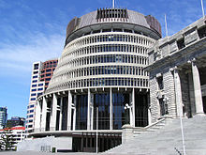
Wellington
It is the capital because it is close to the centre of the country.
It has a population of 370,000.
The New Zealand government meet here.
It is the centre for film, music, and theatre.
Parts of The Lord of the Rings were filmed in and around the town.
The building of the Parliament called
the Beehive. Obr. 2

Slide 5
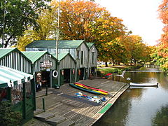
Christchurch
It is the largest town in South Island with 367,000 people.
It is a flat, green place.
One third of the city is parks and gardens, and it is called “the Garden City“.
It is “the most English city outside England “. It was designed in England.
The river there is called the Avon.
Boatsheds on the river Avon
obr. 3

Slide 6
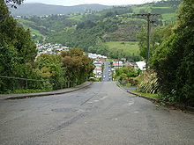
Dunedin Baldwin Street obr. 4
Dunedin is the old name for Edinburgh in Scotland.
It used to be the largest city and an important business centre.
There is the oldest university.
Baldwin Street is the steepest street in the world. Every year there is a race to the top of the street and down.

Slide 7
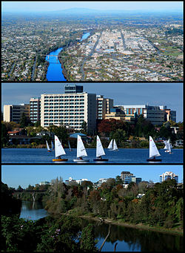
Hamilton
It is the fifth most important city.
It is in the centre of the richest farmland.
The Waikato River flows through the city.
It is growing quickly – many immigrants move here. Obr. 5

Slide 8
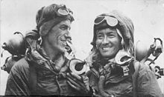
Famous people – Sir Edmund Hillary
He was the first person to stand on the top of Mount Everest with the Nepalese climber Tenzing Norgay on 29 May 1953.
Later he returned to Nepal and helped to build hospitals and schools here. Obr. 6

Slide 9
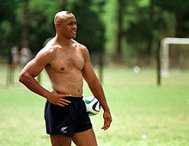
Famous spotsmen
Bruce McLaren was a racing car driver in the 1960s.
Sir Peter Blake won the Whitbread Round the World race in 1989.
Jonah Lomu from the All Black was the first international rugby star.
obr. 7

Slide 10
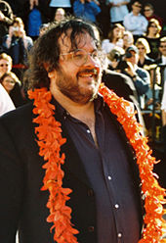
Famous people – Peter Jackson
He worked on the three films of The Lord of the Rings.
The three films together won 17 Oscars.
He still lives and works in New Zealand.
He is working on the three films of Hobbit now.
Obr. 8

Slide 11
Choose the correct words.
Jonah Lomu is famous for playing rugby/car races.
Peter Jackson´s first big success was The Hobbit/The Lord of the Rings.
The All Black are a famous rugby/football team.
Auckland is/ is not the capital city of New Zealand.
The name Dunedin means Edinburgh/Glasgow.

Slide 12
Řešení
Jonah Lomu is famous for playing rugby.
Peter Jackson´s first big success was The Lord of the Rings.
The All Black are a famous rugby team.
Auckland is not the capital city of New Zealand.
The name Dunedin means Edinburgh.

Slide 13
Citace
Obr. 1 XY. wikipedie [online]. [cit. 16.1.2014]. Dostupný na WWW: http://upload.wikimedia.org/wikipedia/commons/thumb/b/b5/AucklandPano_MC.jpg/1280px-AucklandPano_MC.jpg
Obr. 2 XY. wikipedie [online]. [cit. 16.1.2014]. Dostupný na WWW: http://upload.wikimedia.org/wikipedia/commons/thumb/e/e8/Beehive_Building_%26_Parliament_House.JPG/220px-Beehive_Building_%26_Parliament_House.JPG
Obr. 3 XY. wikipedie [online]. [cit. 16.1.2014]. Dostupný na WWW: http://upload.wikimedia.org/wikipedia/commons/thumb/5/53/DunedinBaldwinStreet_Top.jpg/220px-DunedinBaldwinStreet_Top.jpg
Obr. 4 XY. wikipedie [online]. [cit. 16.1.2014]. Dostupný na WWW: http://upload.wikimedia.org/wikipedia/commons/thumb/8/83/AntiguaBoatShedsChristchurch_gobeirne.jpg/240px-AntiguaBoatShedsChristchurch_gobeirne.jpg
Obr. 5 XY. wikipedie [online]. [cit. 16.1.2014]. Dostupný na WWW: http://upload.wikimedia.org/wikipedia/commons/thumb/a/a7/HamiltonMontage.jpg/250px-HamiltonMontage.jpg
Obr. 6 XY. wikipedie [online]. [cit. 16.1.2014]. Dostupný na WWW: http://upload.wikimedia.org/wikipedia/commons/thumb/0/0c/Hillary_and_tenzing.jpg/220px-Hillary_and_tenzing.jpg
Obr.7 XY. wikipedie [online]. [cit. 16.1.2014]. Dostupný na WWW: http://upload.wikimedia.org/wikipedia/commons/thumb/3/3c/Mardel_24-1-01_lomu_en_villa_marista_foto_fabian_gastiarena.jpg/220px-Mardel_24-1-01_lomu_en_villa_marista_foto_fabian_gastiarena.jpg
Obr.8 XY. wikipedie [online]. [cit. 16.1.2014]. Dostupný na WWW: http://upload.wikimedia.org/wikipedia/commons/thumb/e/e0/Peter_Jackson01.jpg/220px-Peter_Jackson01.jpg
Zdroj textu – archiv autora

