Slide 1
Číslo šablony: III/2
VY_32_INOVACE_P2_2.19
Tematická oblast: Reálie
NEW ZEALAND – GENERAL INFORMATION
Typ: DUM - kombinovaný
Předmět: AJ, AJS
Ročník: 6. r.(6leté), 4. r. (4leté)
Zpracováno v rámci projektu
EU peníze školám
CZ.1.07/1.5.00/34.0296
Zpracovatel:
Mgr. Petra Bruková
Gymnázium, Třinec, příspěvková organizace
Datum vytvoření: leden 2014

Slide 2
Metodický list
DUM seznamuje studenty se základními informacemi o Novém Zélandu formou prezentace. Jsou zde uvedena fakta o zeměpise, historii, fauně, flóře a oblíbených sportech. Na tento DUM navazuje DUM o novozélandských městech a známých osobnostech.
DUM procvičuje získané vědomosti pomocí cvičení v závěru prezentace. Součástí DUMu je i řešení cvičení.
Inovativnost materiálu spočívá ve využití ICT techniky.
Klíčová slova:
Maori, Abel Tasman, Aoraki Mount Cook, kiwi, kauri, the All Blacks

Slide 3
NEW ZEALAND

Slide 4
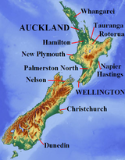
Geography
Obr. 1
There is nowhere more than 130 km from the sea.
It is the same size as GB but the population is only 4.1 mil people.
It has mild weather (the hottest months are December – February, the coldest ones are June – August)
The warmest part is the North Island. Obr. 2

Slide 5
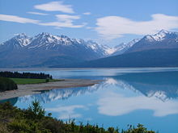
Geography
There are 3 high volcanos – Ruapehu, Ngauruhoe, and Tongariro (active in 1996 and 2006).
The biggest river is Waikato which makes electricity for NZ.
The Southern Alps in the South Island have the highest mountain Aoraki Mount Cook (3,754 m). obr. 3

Slide 6
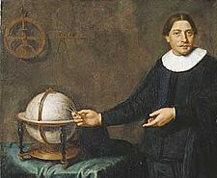
History obr. 4
The first inhabitants were Maori (they came to NZ 1,000 years ago).
They called NZ Aotearoa – the land of the long white cloud.
In 1642 the Dutch sailor Abel Tasman visited NZ and called it Zeeland.
In 1840 Captain William Hobsow wrote the Treaty of Waitangi. It said the Queen Victora became the Queen of NZ.

Slide 7
History
In 1863 gold was found in the South Island – many people from Britain came there.
In 1893 NZ was the first country where women could vote.
In 1930s schools and hospitals started to be free for all people.

Slide 8
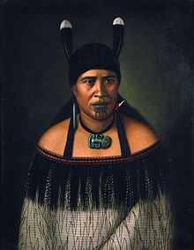
Maori
They are tall people with brown skin and black hair.
Their population was originally 100,000 – 150,000 people.
They used to live in wooden houses, caught birds and fish, and grew sweet potatoes.
They are excellent singers and dancers.
Many of them died when the British fought with them because of the land (the population dropped to 50,000 people).
Nowadays 15% of population are Maori, they have worse living conditions than other obr. 5 inhabitants.

Slide 9
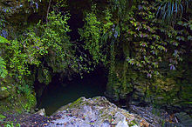
Wonders of New Zealand
Volcanos of Auckland´s hills – Rangitoto is the youngest – only 600 years old.
Rotorua – a city in the centre of the North Island where the air smells like eggs and hot water obr.6 expodes from the ground.
Waitomo Caves – can be
visited by boat and
flies lit the ceiling there. obr.7

Slide 10
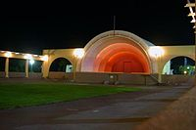
Wonders of New Zealand
Napier – a city destroyed by the earthquake in 1931 and rebuilt in the Art Deco style.
Franz Josef and Fox Glaciers. Obr. 8
Milford Track – lasts four days and you can see 580 m high Sutherland Falls.

Slide 11
Agriculture
NZ used to “live off the sheep´s back“.
For every person there are 10 sheep and 2 cows ( 40 mil sheep and 8 mil cows).
Apples, grapes and kiwifruit are grown there.
Trees are grown for wood and paper.

Slide 12
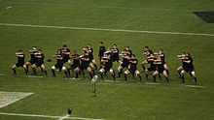
Free time and sports
Because of good weather people spend a lot of time in gardens having barbecues.
They like a hangi – a Maori way of cooking.
Popular sports are soccer, rugby, tennis, running, netball and golf. They take part in horse races in Australia, too.
The New Zealand rugby team is called the All Blacks. Before a game of rugby, the team do a haka – a Maori dance – to frighten the other team. Obr. 9

Slide 13
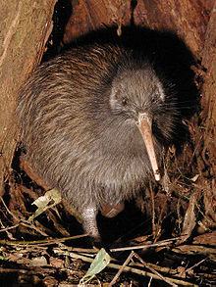
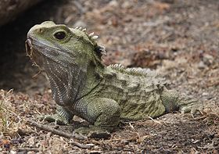
Animals, birds, and plants
Kiwi – a small bird which cannot fly. New Zealanders are called Kiwis. obr. 10
Kakapo – an endangered bird. There are less than a hundred of them living.
Tuatara – lives on small obr. 11 islands, one of the oldest animals in the world, it has a third eye – it wakes up the animal after winter sleep.

Slide 14
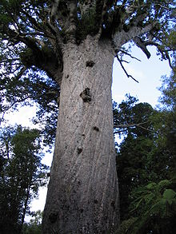
Pohutukawa tree – it has red flowers at Christmas time so people call it the New Zealand Christmas tree.
Kauri – the tallest kauri is 52 m tall and more than 1,500 years old. Obr. 12

Slide 15
Fill in the gaps with suitable words.
The temperature is ……….between June and August, and the ……….part of the country is colder than the north.
Aoraki Mount Cook, in the Southern…….., is New Zealand´s ……….mountain.
In 1863 many people came to NZ because ……….was found there.
New Zealand was the ……..country to let ………vote.
A Dutch …………gave New Zealand its ……..

Slide 16
Match the place with the explanation.
1. Waitako a) caves
2. Aoraki b) original inhabitants
3. Maori c) a river
4. Aotearoa d) the highest moutain
5. Waitomo e) the original name
of the island

Slide 17
Řešení
Fill in the gaps with suitable words.
the lowest, south
Island, highest
gold
first, women
Abel Tasman, name
Match the place with the things you find there.
1.C
2.D
3.B
4.E
5.A

Slide 18
Citace
Zdroj textu – archiv autora
Obr. 1 XY. wikipedie [online]. [cit. 16.1.2014]. Dostupný na WWW: http://upload.wikimedia.org/wikipedia/commons/thumb/3/3e/Flag_of_New_Zealand.svg/125px-Flag_of_New_Zealand.svg.png
Obr. 2 XY. wikipedie [online]. [cit. 16.1.2014]. Dostupný na WWW:
http://upload.wikimedia.org/wikipedia/commons/thumb/3/3e/Flag_of_New_Zealand.svg/125px-Flag_of_New_Zealand.svg.png
Obr. 3 XY. wikipedie [online]. [cit. 16.1.2014]. Dostupný na WWW:
http://upload.wikimedia.org/wikipedia/commons/thumb/6/6a/Tasman_Valley_-_Aoraki_Mount_Cook_-_Canterbury.jpg/220px-Tasman_Valley_-_Aoraki_Mount_Cook_-_Canterbury.jpg
Obr. 4 XY. wikipedie [online]. [cit. 16.1.2014]. Dostupný na WWW:
http://upload.wikimedia.org/wikipedia/commons/thumb/f/f8/AbelTasman.jpg/225px-AbelTasman.jpg
Obr. 5 XY. wikipedie [online]. [cit. 16.1.2014]. Dostupný na WWW:
http://upload.wikimedia.org/wikipedia/commons/thumb/7/7b/Hinepare.jpg/220px-Hinepare.jpg
Obr. 6 XY. wikipedie [online]. [cit. 16.1.2014]. Dostupný na WWW:
http://upload.wikimedia.org/wikipedia/commons/thumb/5/51/Rotorua_museum.jpg/240px-Rotorua_museum.jpg
Obr. 7 XY. wikipedie [online]. [cit. 16.1.2014]. Dostupný na WWW:
http://upload.wikimedia.org/wikipedia/commons/thumb/a/a1/Waitomo_Cave_Entrance_n.jpg/220px-Waitomo_Cave_Entrance_n.jpg
Obr. 8 XY. wikipedie [online]. [cit. 16.1.2014]. Dostupný na WWW:
http://upload.wikimedia.org/wikipedia/commons/thumb/e/e9/Napier-SoundShell.jpg/200px-Napier-SoundShell.jpg
Obr. 9 XY. wikipedie [online]. [cit. 16.1.2014]. Dostupný na WWW:
http://upload.wikimedia.org/wikipedia/commons/thumb/2/24/Haka.jpg/220px-Haka.jpg
Obr. 10 XY. wikipedie [online]. [cit. 16.1.2014]. Dostupný na WWW:
http://upload.wikimedia.org/wikipedia/commons/thumb/8/82/TeTuatahianui.jpg/220px-TeTuatahianui.jpg
Obr. 11 XY. wikipedie [online]. [cit. 16.1.2014]. Dostupný na WWW:
http://upload.wikimedia.org/wikipedia/commons/thumb/5/52/Tuatara.jpg/280px-Tuatara.jpg
Obr. 12 XY. wikipedie [online]. [cit. 16.1.2014]. Dostupný na WWW:
http://en.wikipedia.org/wiki/Agathis_australis

