Slide 1

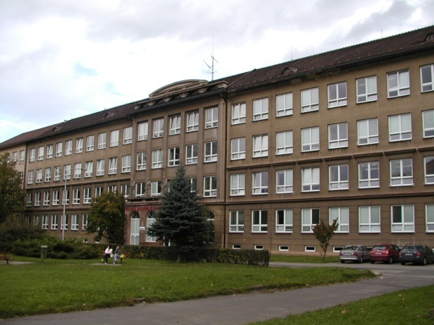
Číslo šablony: III/2
VY_32_INOVACE_P1_2.4
Tematická oblast: Festivals and Celebrations
Easter in the USA and Great Britain
Typ: DUM - kombinovaný
Předmět: AJ
Ročník: 2. r. (6leté)
Zpracováno v rámci projektu
EU peníze školám
CZ.1.07/1.5.00/34.0296
Zpracovatel:
Mgr. Petra Bruková
Gymnázium, Třinec, příspěvková organizace
Datum vytvoření: březen 2012

Slide 2
Metodický list
DUM seznamuje studenty se základními informacemi
o Velikonocích, jak se slaví v anglicky mluvících zemích, zejména
ve Velké Británii a USA. DUM je zpracován formou prezentace
a procvičuje získané vědomosti pomocí cvičení v závěru prezentace.
Součástí DUM je i řešení cvičení. Snímky se mohou využít k souvislému vypravování. Některé obrázky slouží k popisu
a zdůvodnění jejich souvislosti se státním svátkem.
Inovativnost materiálu spočívá ve využití ICT techniky.
Klíčová slova:
Easter, Easter card, Bunny, hot cross buns, Easter bonnets, egg hunt

Slide 4
Easter
It is the most important festival in the church year.
It begins with Good Friday – the day when the Romans killed Jesus Christ.
Two days later, on Easter Sunday, Christians believe that Jesus returned to life.
It comes from a pagan word Eostre.
It is celebrated the first full moon after the first day of spring.

Slide 5
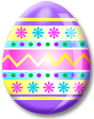
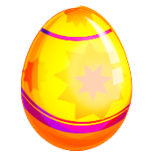
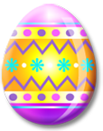

Easter Eggs
They are symbols of spring and a new life.
On Easter Sunday people give chocolate Easter eggs as presents.
Some children believe that Easter Bunny hides the eggs for them in the garden. Children must look for them.
Another Easter tradition is “egg-rolling“. People take decorated eggs to the top of a hill and the eggs roll down. The first egg to get down is the winner.

Slide 6
Traditions
Traditionally people eat hot cross buns.
These are small loaves of bread, baked with spices and fruit, and they have a cross on the top. They are best hot.
Some women and girls decorate hats, called Easter bonnets.
They put lots of spring flowers on them and wear them in Easter bonnet parades.

Slide 7
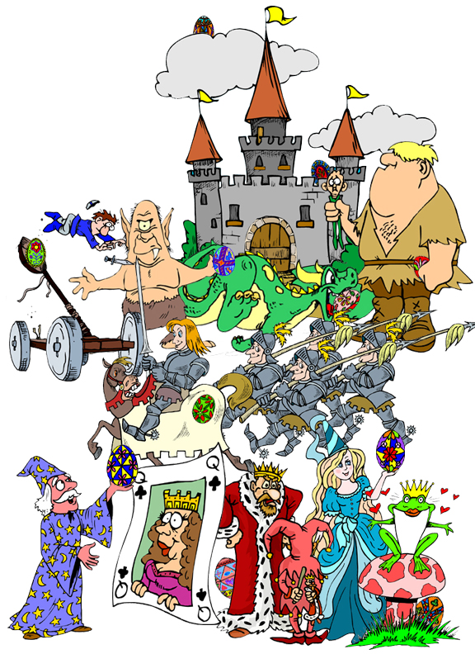
Writing practice: Find as many Easter eggs as you can and then write down their location. Try to detailed answers.
Example: There is an Easter egg behind the mushroom in the grass.
Zdroj obrázku:
http://bogglesworldesl.com/easter_worksheets.htm

Slide 8
Easter Rhymes
Find rhyming words that match the clues.
A season that rhymes with a drink.
What birds lay that rhymes with legs.
A meal that rhymes with a winner.
Something you send that rhymes with hard.
Another word for rabbit that rhymes with honey.
The opposite of find that rhymes with a side.
A search that rhymes with bunt.

Slide 9
How many words can you make out of
EASTER EGG HUNT?

Slide 10
Řešení
Easter Rhymes - find rhyming words that match the clues.
spring
eggs
dinner
card
Bunny
hide
hunt
How many words can you make out of EASTER EGG HUNT?
Students´ own answers.

Slide 11
Zdroje
Kliparty společnosti Microsoft
Zroj textu – archiv autora

