Slide 1
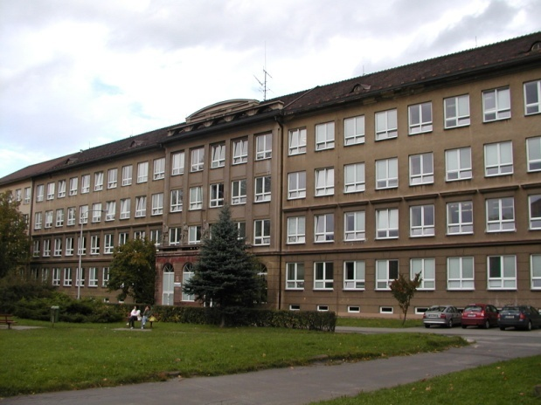
Číslo šablony: III/2
VY_32_INOVACE_P1_2.17
Tematická oblast: Festivals and Celebrations
FAMILY CELEBRATIONS
IN THE CZECH REPUBLIC
Typ: DUM - kombinovaný
Předmět: AJ
Ročník: 4. r . (6leté), 2. r. (4leté)
Zpracováno v rámci projektu
EU peníze školám
CZ.1.07/1.5.00/34.0296
Zpracovatel:
Mgr. Petra Bruková
Gymnázium, Třinec, příspěvková organizace
Datum vytvoření: únor 2013

Slide 2
FAMILY CELEBRATIONS IN THE CZECH REPUBLIC WEDDINGS

Slide 3
Metodický list
DUM seznamuje studenty se základními informacemi o rodinných oslavách, zejména svatbě, formou prezentace .
DUM procvičuje získané vědomosti pomocí popisu obrázků v závěru prezentace. Žáci by měli hovořit samostatně v rozsahu dvou minut.
Inovativnost materiálu spočívá ve využití ICT techniky.
Klíčová slova:
wedding, marriage, ring, traditions, bride, groom, kidnapping

Slide 4
Family Celebrations
People in the Czech Republic celebrate a lot of holidays, e.g.
birthday,
nameday,
christening,
but the most important in people´s lives is a wedding.

Slide 5
Preparations
A few weeks before the wedding small cakes and cookies are baked.
They are given to relatives, friends and neighbours.
At the same time the guests are invited to the wedding.

Slide 6
The Right Day
Most weddings take place on Saturday.
Few weddings are in May as this month is said to be unlucky for newly married couples.

Slide 7
Wedding Decorations
All wedding guests must have a spring of myrtle.
All cars must be decorated with ribbons nad springs of myrtle.
The bride and the groom cannot go by the same car, the groom´s car leads the convoy of cars while the bride is the last one.

Slide 8
Exchanging Rings
It is the sealing of an important agreement.
The symbol of an agreement between God and the married couple.
They are placed on the ring finger of the left hand. There it follows a direct artery to the heart.

Slide 9
Traditions Eating at the Wedding Reception
At a wedding reception the bride and the groom are covered with a large cloth and they eat soup using one plate and one spoon.
It symbolizes the trust that they can rely on the other in time of need.
Cutting the wedding cake is another tradition.
The couple make the first cut together to symbolise their shared future.

Slide 10
Traditions during the Wedding Reception
Flower Bouquet Toss
The bride throws the flower bouquet over her shoulder into a crowd of single women. The lucky lady who catches the bouquet is the next one to get married.
Dancing
The bride and the groom dance the first dance .
The bride and her father and the groom and his mother dance the second one.

Slide 11
Traditions during the Wedding Reception
Breaking a Plate
At a wedding reception a plate is broken and the bride and the groom must clean the pieces. They show the ability to work together. And the chips bring happiness.
Kidnapping of the Bride
When the reception is nearly over, friends kidnap the bride. The groom must look for her and pay a ransom. This is a symbol of bride´s separation from her parents.

Slide 12
Beware
The bride should not have the same dress as her mother.
The wedding dress should not be blue or purple. These colours symbolize black eyes in a marriage.
The bride should not wear pearls – they symbolize tears.
The bride should not change her wedding dress before midnight.
The groom should not see the bride in her wedding dress before the wedding.

Slide 13
Exercise
Describe the photos in details.

Slide 14
Zdroje
Kliparty společnosti Microsoft
Fotky – archiv autora

