Slide 1

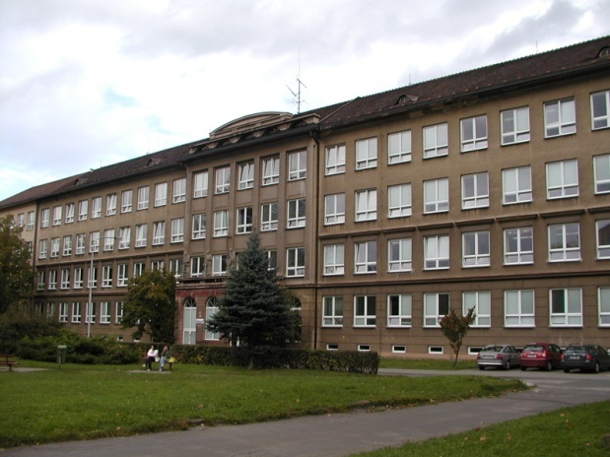
Číslo šablony: III/2
VY_32_INOVACE_P1_2.1
Tematická oblast: Festivals and Celebrations
ST. VALENTINE´S DAY
Typ: DUM - kombinovaný
Předmět: AJ
Ročník: 4. r . (6leté), 2. r. (4leté)
Zpracováno v rámci projektu
EU peníze školám
CZ.1.07/1.5.00/34.0296
Zpracovatel:
Mgr. Petra Bruková
Gymnázium, Třinec, příspěvková organizace
Datum vytvoření: únor 2012

Slide 2

ST. VALENTINE´S DAY

Slide 3
Metodický list
DUM seznamuje studenty se základními informacemi
o svátku Sv. Valentýna formou prezentace .
DUM procvičuje získané vědomosti pomocí cvičení v závěru prezentace. Součástí DUM je i řešení cvičení. Snímky se mohou využít k souvislému vypravování. Obrázky slouží k popisu a zdůvodnění jejich souvislosti se státním svátkem.
Inovativnost materiálu spočívá ve využití ICT techniky.
Klíčová slova:
St. Valentine´s Day, symbols, Cupid, Valentine cards

Slide 4

St. Valentine´s Day
It is a time when people show feelings of love, affection and friendship.
It is celebrated in many ways worldwide on February 14 each year.

Slide 5
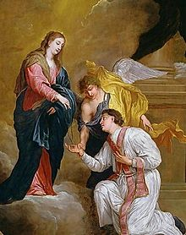
The Origin
The legend says that this day became known as a Saint Valentine´s Day thanks to the priest Valentine who really lived and secretly married young couples.
He married soldiers who were forbidden to marry. It was believed that married men were not good soldiers.
He was arrested and executed exactly on February 14.

Slide 6

Symbols
hearts
red and pink colours
roses
images and statues of Cupid

Slide 7
Cupid
Cupid is usually portrayed as a small winged figure with a bow and arrow.
In the mythology he uses his arrow to hit the hearts of people.
Cupid´s bows and arrows symbolize the feeling of romance and love on St. Valentine´s Day.

Slide 8
What do people do?
Many people show appreciation for the people they love or adore.
They take them for a romantic dinner, exchange anonymous Valentine´s cards, boxes of chocolates, jewellery, bunches of flowers.

Slide 9


Valentine´s Cards
They date back to the third century.
In prison Valentine started to love the daughter of a man who worked in the prison.
The day he died, he sent a note to this woman signed “Your Valentine“.
People started to send Valentine´s cards in the early 19th century when the post office started in Britain.

Slide 10
St. Valentine´s Day Secret Code
Use the alphabet code to find a Valentine poem.
A | B | C | D | E | F | G | H | I | J | K | L | M | N | O | P | Q | R | S | T | U | V | W | X | Y
F | I | B | U | V | A | R | E | D | T | Y | H | X | K | L | P | N | W | Q | G | O | Z | M | J | C
- - - - - - - - - -,
W L Q V Q F W V W V U
- - - - - - - - - - - - -,
Z D L H V G Q F W V I H O V
- - - - - - - - - - -,
Q O R F W D Q Q S V V G
- - - - - - - - - -,
F K U Q L F W V J L O

Slide 11
Valentine´s Word Jumble
Unscramble the letters to find words about Valentine´s day.
sski……………. ymrar……….
dacr………… jeeyellrw………
orleswf……... trahe………..
uocpel……… rawro………..
roess……….. dynac………..
voel…………. teews………..
udcip……….. uhg………….
dtea…………... yrurafeb…….

Slide 12
Řešení
Valentine´s Day Secret Code
Roses are red, violets are blue,
Sugar is sweet, and so are you.
Valentine´s Word Jumble
Kiss, card, flowers, couple, roses, love, Cupid, date, marry, jewellery, heart, arrow, candy, sweets, hug, February.

Slide 13
Zdroje
http://upload.wikimedia.org/wikipedia/commons/thumb/d/d6/St-Valentine-Kneeling-In-Supplication.jpg/220px-St-Valentine-Kneeling-In-Supplication.jpg
kliparty společnosti Microsoft
text – archiv autora

